Slide 1
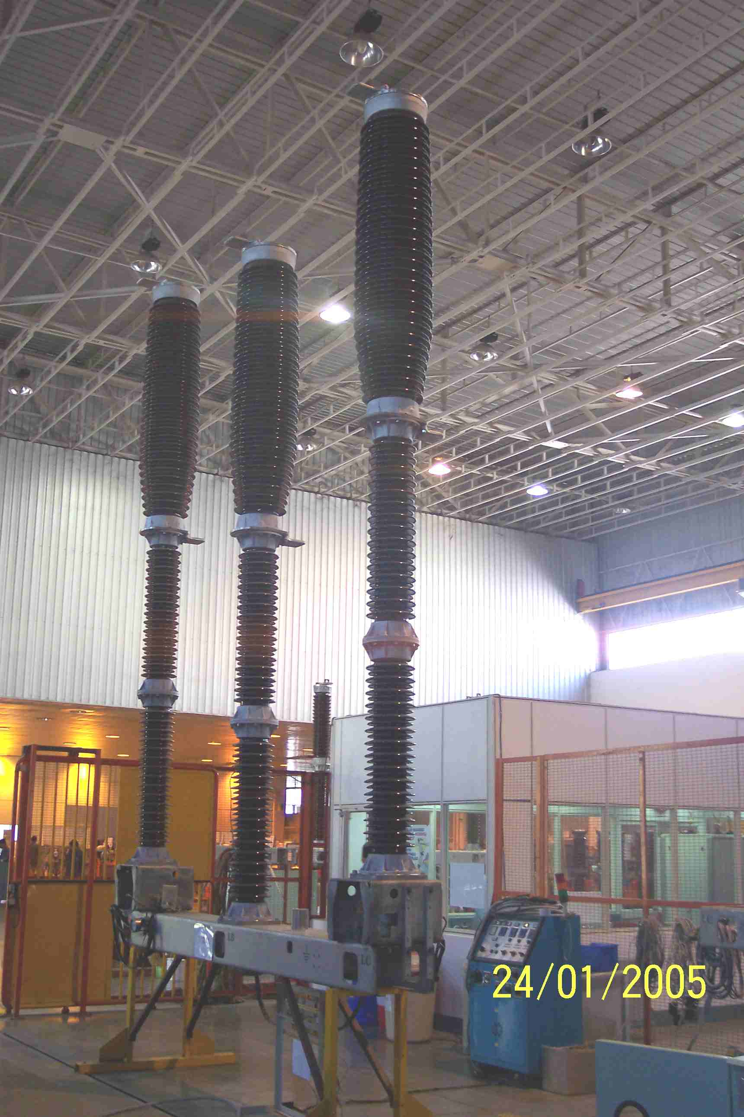
SIEMENS
HVCB SPARES
Complete pole , 245KV, 50KA CB
S4799213001

